Slide 1
Why CSCW?

Slide 2
Outline
What is CSCW
Key trends over time
Core Issues in CSCW

Slide 3
References
https://www.interaction-design.org/encyclopedia/cscw_computer_supported_cooperative_work.html
See also papers posted on GitHub! (Grudin, Bannon, Dourish)

Slide 4
“Almost everything we do depends on collaboration. Any system, process or technology involves collaboration. And, as a creature that is continually evolving and creating new ways of doing things, this means that the foundation, measures and methods of collaboration are also changing.” Together Works: The Ultimate Guide to Ecollaboration (Dr D Avery, J Hogan, R McIntyre)
Notes:
https://www.glasscubes.com/are-you-working-apart-or-working-together-apart/

Slide 5
From HCI to CSCW….
Computers and computation were expensive… focus was on technology
Shift towards HCI and interaction paradigms:
electronic
Symbolic
textual
graphical
Initially integrated models on humans in design…
Shift to study how humans work and use technology: “From Human Factors to Human Actors” (Dourish)

Slide 6
Earliest CSCW researchers?
Douglas Engelbart (inventor of the mouse) – designed the NLS system from 1967!
Comprised of CRT displays, a mouse for each station and hypermedia versions of the laboratory’s knowledge base
http://www.interaction-design.org/encyclopedia/cscw_computer_supported_cooperative_work.html

Slide 7
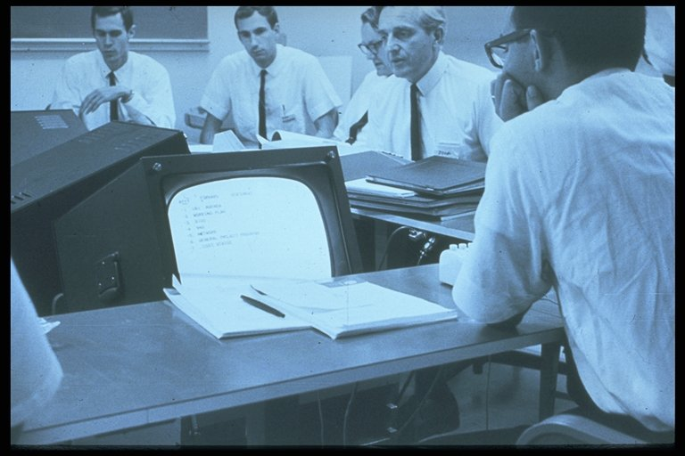
http://www.youtube.com/watch?v=XiJA7_Sw9aM
http://www.interaction-design.org/encyclopedia/cscw_computer_supported_cooperative_work.html
Notes:
http://www.youtube.com/watch?v=XiJA7_Sw9aM
Precursors of desktop and video conferencing
Figure 27.1 A-B: Douglas Engelbart and staff using NLS to support 1967 meeting with sponsors - probably the first computer-supported conference. The facility was rigged for a meeting with representatives of the ARC's research sponsors NASA, Air Force, and ARPA. A U-shaped table accommodated setup CRT displays positioned at the right height and angle. Each participant had a mouse for pointing. Engelbart could display his hypermedia agenda and briefing materials, as well as the documents in his laboratory's knowledge base.

Slide 8
CSCW – a multidisciplinary field
Early researchers (Irene Grief, 1984) and others recognized the need to learn from
Anthropologists
Social scientists
Economists
Designers
Educators

Slide 9
Some definitions of CSCW
CSCW
is about groups of users – how to design systems to support their work as a group and how to understand the effect of technology on their work patterns.
Dix, Finlay, Abowd & Beale Human Computer Interaction, 2nd Ed. Prentice Hall. 1998
is the study of the electronic workplace – an organization-wide system that integrates information processing and communication activities.
Ellis, Gibbs & Rein Groupware: some issues and experiences, Comm ACM 34(1) 1991
http://pages.cpsc.ucalgary.ca/~saul/781

Slide 10
CSCW Trends

Slide 11
From office automation to understanding collaborative work
Early attempts to automate the office failed!
Focus was on automating procedures, processes
Rather than practice…
Much office work involves “cultural” aspects as well as “informal” processes
Originally automation automated the processes rather than supported the work and how it was done
http://www.interaction-design.org/encyclopedia/cscw_computer_supported_cooperative_work.html

Slide 12
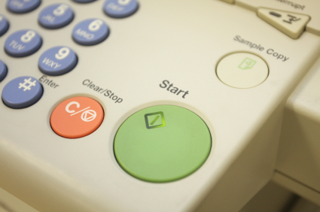
Emergence of Ethnography to study CSCW
Used to study teams and organizations
Famous example: studying photocopier use at Xerox Parc
http://www.interaction-design.org/encyclopedia/cscw_computer_supported_cooperative_work.html
Notes:
http://uxmag.com/articles/busting-the-myth-of-the-giant-green-button for a discussion on this.

Slide 13
Software Trends: Groupware (1980’s)
Software that supports group work
Focus on algorithms and architectures fundamental to supporting group activities (e.g. collaborative text editing)
http://www.interaction-design.org/encyclopedia/cscw_computer_supported_cooperative_work.html

Slide 14
Groupware and CSCW
Groupware
software that supports group work
investigate algorithms & architectures fundamental to multi-user systems
Computer Supported Cooperative Work (CSCW)
knowledge about the context of groupware design
investigate individual/group/organizational requirements for multi-user systems
feedback
http://pages.cpsc.ucalgary.ca/~saul/781
Notes:
Some slides as indicated are adapted from Saul’s slides at: http://pages.cpsc.ucalgary.ca/~saul/781/readings.html

Slide 15
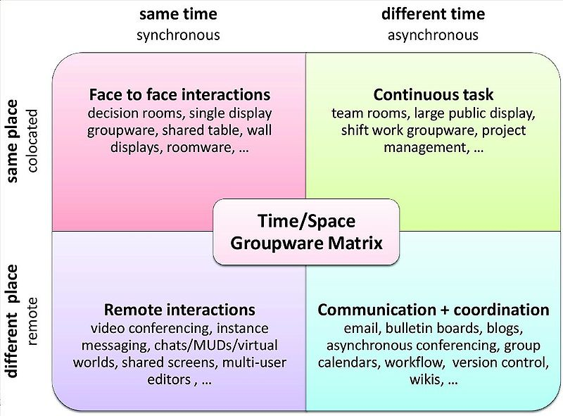

Slide 16
But…
Groupware term faded as shift towards organization-wide deployment and collaboration became commonly integrated in more applications (all software is now groupware?)
http://www.interaction-design.org/encyclopedia/cscw_computer_supported_cooperative_work.html
Notes:
Google doc and Office now has word and other tools that support asychronous editing.

Slide 17
Move from space to place
A space is where we put things
A place is where activities occur
Users, not designers, manage meaning
Users, not designers, manage coupling
(Dourish’s design principles)
From http://www.dourish.com/embodied/
Notes:
Dourish slideshttp://www.dourish.com/embodied/

Slide 18




Place
Space
P. Dourish and V. Bellotti. Awareness and Coordination in Shared Workspaces. Proceedings of the ACM Conference on Computer-Supported Cooperative Work (CSCW'92).
Notes:
The use of these communication tools in conjunction with sophisticated IDEs, as well as the rise of software ecosystems and need for distributed development of large, ultra-scale projects, has led to what
Paul Dourish refers to - a space to place transformation in development tools and repositories.
It is no longer sufficient to store versions and configurations of software, and to communicate about the shared development, but rather the tools have become a place where developers, meet, hang out, learn from each and work together more effectively.

Slide 19
Trends: Communication Media
A lot of early research was on “computer-mediated communication”, especially through email
Early days (early 80’s) – didn’t work so well
Not interoperable, confined to researchers
Today there is also consideration of how communication occurs on other channels (discussion forums, blogs, Twitter, Stackoverflow etc)
http://www.interaction-design.org/encyclopedia/cscw_computer_supported_cooperative_work.html

Slide 20
Trends: Devices
Early research focused on videoconferencing and tools for email
Now consideration is shifted to broader technologies, including much more attention on mobile technologies
http://www.interaction-design.org/encyclopedia/cscw_computer_supported_cooperative_work.html

Slide 21
From Groups to Networks and communities
Wide adoption of internet and social media led to a critical mass of participation: crowdsourcing and viral diffusion
Network analysis, data mining, machine learning became prominent tools to study these phenomena
Transparency led to many analyses in research (but some tools restrict studies, e.g. Facebook)
http://www.interaction-design.org/encyclopedia/cscw_computer_supported_cooperative_work.html

Slide 22
Summary of trends…
Then | Now
Groupware | CSCW
Email, video conferencing | Social media
Document management systems | Repositories with versions, wikis
Workflow management | Social networking, enterprise networking, location awareness
Automate a fiction | Ethnography
http://www.interaction-design.org/encyclopedia/cscw_computer_supported_cooperative_work.html

Slide 23
Core issues for CSCW?

Slide 24
Should consider…
What is the difference between work created in seclusion as compared to work that is done cooperatively? (Bannon)
What are the emergent work patterns?
What is a group? Is it a fixed ensemble of people sharing the same “goal”? But shared is still murky! Is it “we”?
A focus on “context”
“settings in which action unfolds, how action is related to those settings” (Dourish)

Slide 25
Some key concepts…
Articulating cooperative work
Sharing an information space
Adapting the technology to the organization and vice versa
Notes:
Are these the core issues?

Slide 26
Articulation Work
Consists of all tasks needed to coordinate a particular task, manage subtasks, recover from errors and assemble resources
Can’t always predict what is needed – continually need to negotiate and renegotiate
Shouldn’t “automate a fiction”
But one person’s articulation work may be another person’s work
Notes:
“numerous tasks, clusters of tasks, and segments of trajectory of tasks need to be meshed”
“likewise the efforts of individuals and ensembles need to be meshed”
Issues: task uncertainty, contradictory environment… leads to articulation cannot be planned in advance
Requires lots of negotiation and renegotiation continuously.
Need to be careful that we don’t “automate a fiction”
Difficulties in capturing “tacit knowledge” and “day to day informal practices”
Systems that neglect the articulation work that makes the flow of information possible can lead to serious problems
“double level languages”
System needs to provide multiple alternative channels of interaction
Need “formal” and “cultural” aspects of language…
“formal level is meaningless without interpretation and the cultural level is vacuous without being grounded”
Talk about work to rule and office automation
One system that does so at the expense of the other will fail!
See quote p. 366

Slide 27
Social psychology
McGrath’s framework for categorizing team behaviours:
http://www.interaction-design.org/encyclopedia/cscw_computer_supported_cooperative_work.html
Notes:
For example, no one could prove a productivity benefit for email. Eventually people stopped questioning it. On the other hand, group support systems (electronic meeting rooms, a major focus of research in the 1980s and commercialization attempts in the 1990s) did well in controlled studies but were never commercially successful. Why?
Some technologies that show no positive effects in lab studies that focus on performance can provide benefits in other cells. They can aid in conflict resolution or problem-solving, enable people to achieve recognition or status, and so on. Videoconferencing can have subtle effects that are difficult to measure in terms of return on investment: It can assist conflict-resolution or problem-solving (Williams, 1997), and if people like it, it could strengthen group ties.

Slide 28
Takeaway: productivity is hard to measure! And may not be reliable!
http://www.interaction-design.org/encyclopedia/cscw_computer_supported_cooperative_work.html

Slide 29
Up Next?
Theories and models…
Distributed Cognition
Awareness
Distance Matters
Model of Coordinated Action (MoCA)
Notes:
Should have some time before the first break!!!!

